Slide 1

WISEPRICE
GADGETS PRICE ANALYSIS AND TRACKING TOOL

Slide 2

PRESENTED BY :
30. Maanav Chellani
31. Rashi Chellani
32. Parth Dabholkar
33. Anish Dayani
34. Vedant Devkar
35. Viraj Dighe

Slide 3
Table Of Contents
1
4
INTRODUCTION
RESOURCES
PLAN
2
BUDGET
5
SCHEDULE
3
CONCLUSION
6

Slide 4
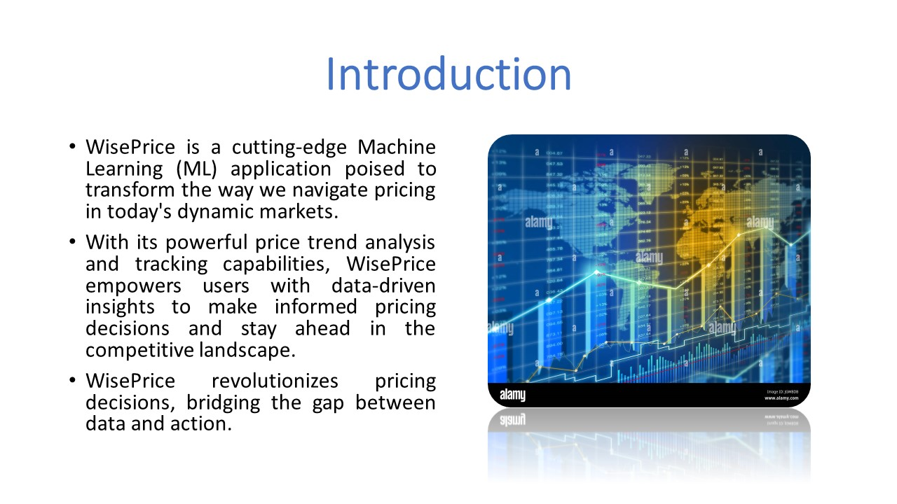

Slide 5
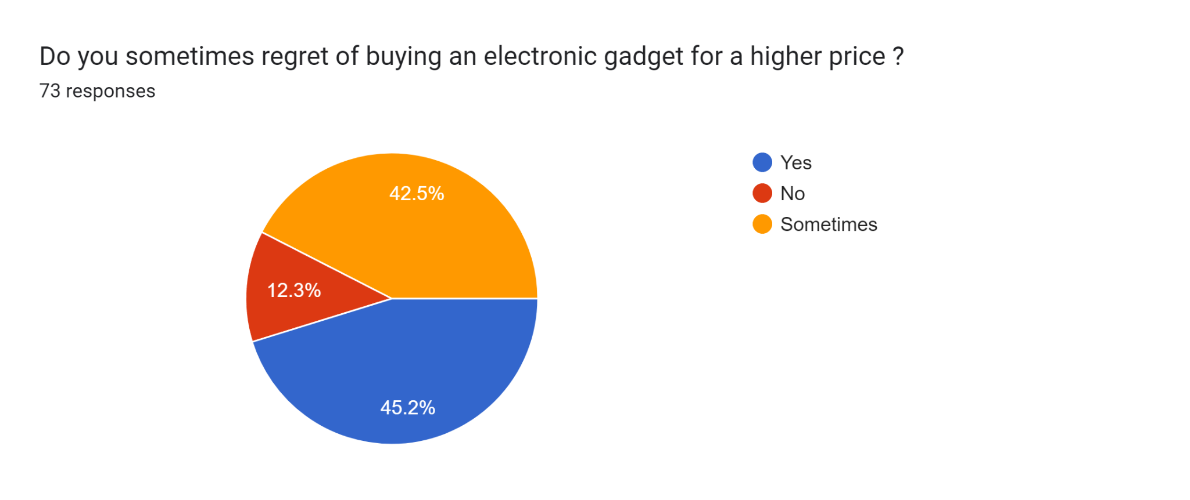
SURVEY

Slide 6
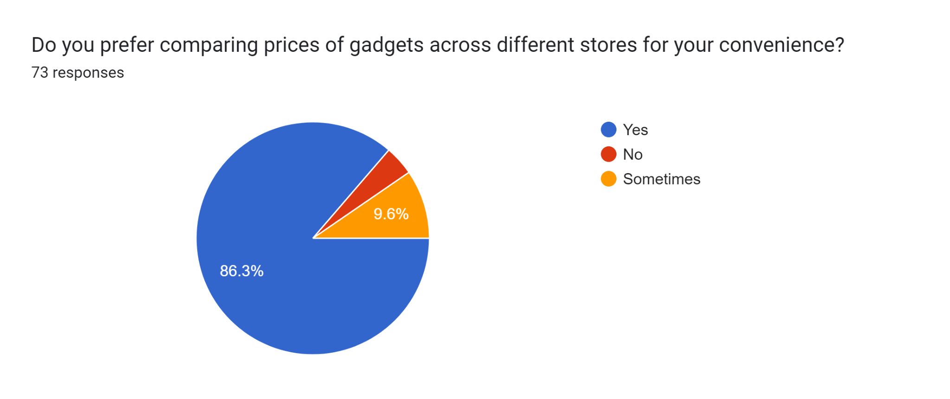
SURVEY

Slide 7
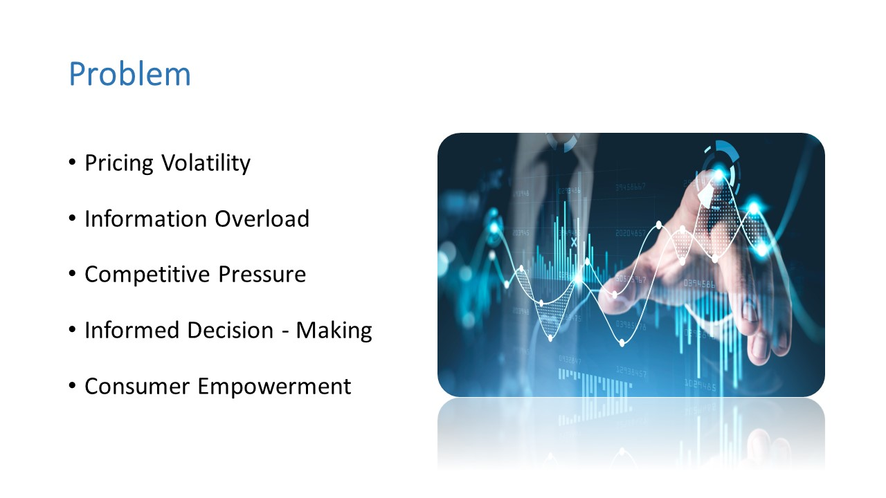

Slide 8
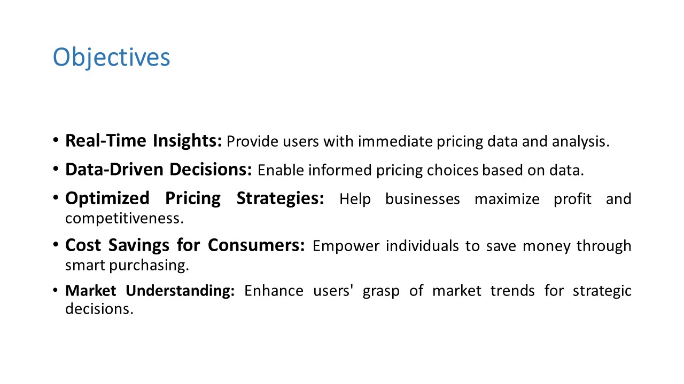

Slide 9

Plan
•Project Initialization : Team assembly, define roles.
•Data Collection and Preprocessing : Acquire data, clean data, extract features.
•Model Development : Choose ML algorithms, implement forecasting, train , evaluate.
•Web App Development : Design user interface, develop backend systems, integrate .
•Real-time Updates : Implement data pipeline, create notification system.

Slide 10

Plan
•Testing & Optimization : Conduct extensive testing, fine-tune.
•Deployment & Monitoring : Deploy to production, continuous monitoring, user feedback.
•Project Conclusion : Document project details, user training, final evaluation.

Slide 11
Schedule
Phase 1: Project Initialization | Project Kickoff Data Collection Strategy Infrastructure Setup | 1 Week
Phase 2: Data Collection and Preprocessing | Data Cleaning Feature Engineering | 5 Days
Phase 3: Model Development | Algorithm Selection Time Series Forecasting Model Training | 1 week
Phase 4: Web Application Development | Frontend Development Backend Development Integration | 8 days

Slide 12
Schedule
Phase 5: Real Time Updates | Data Pipeline Notification System | 1 Week
Phase 6: Testing and Optimization | Testing Optimization | 5 Days
Phase 7: Deployment and Monitoring | Deployment Monitoring User Feedback Collection | 1 week
Phase 8: Project Conclusion | Documentation Training Final Evaluation | 1 Week

Slide 13

Resources
1. Human Resources
•Data Scientists and ML Engineers (2-3)
•Web/Mobile App Developers (2-3)
•Data Engineers (1-2)

Slide 14

Resources
2. Hardware and Software Resources
• Cloud Computing (AWS, Azure, Google Cloud)
• GPU Instances
• High-performance Data Storage

Slide 15
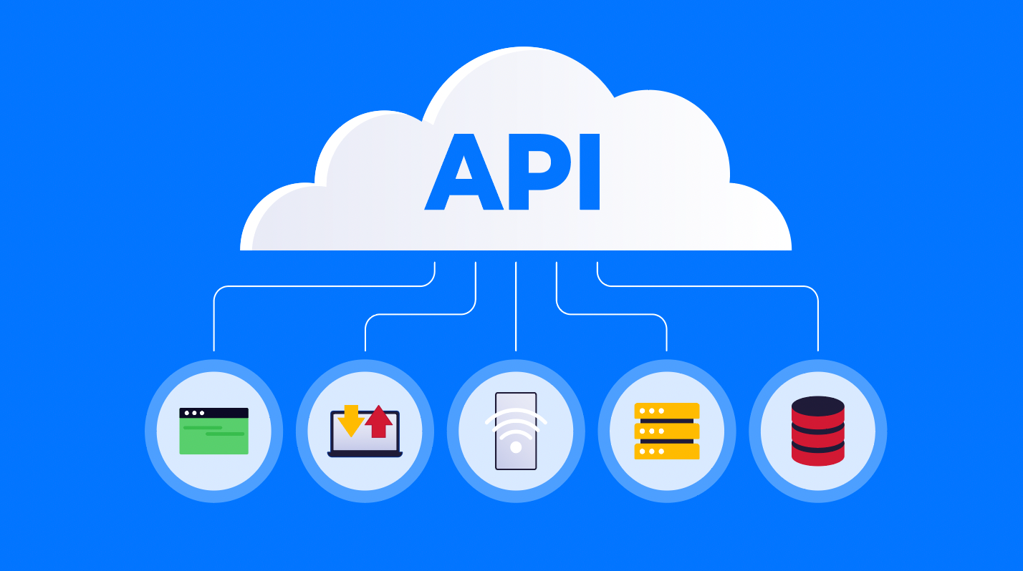
Resources
3. Data Sources and APIs
• Access to Electronic Product Pricing Data
• API Integration for Real-time Data
4. Budget
• Data Acquisition Budget for Enhanced Models
.

Slide 16
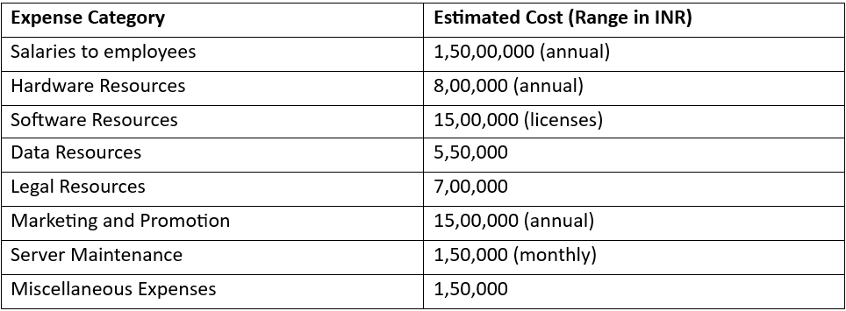
BUDGET
TOTAL COST – ₹ 2.2 CRORES

Slide 17
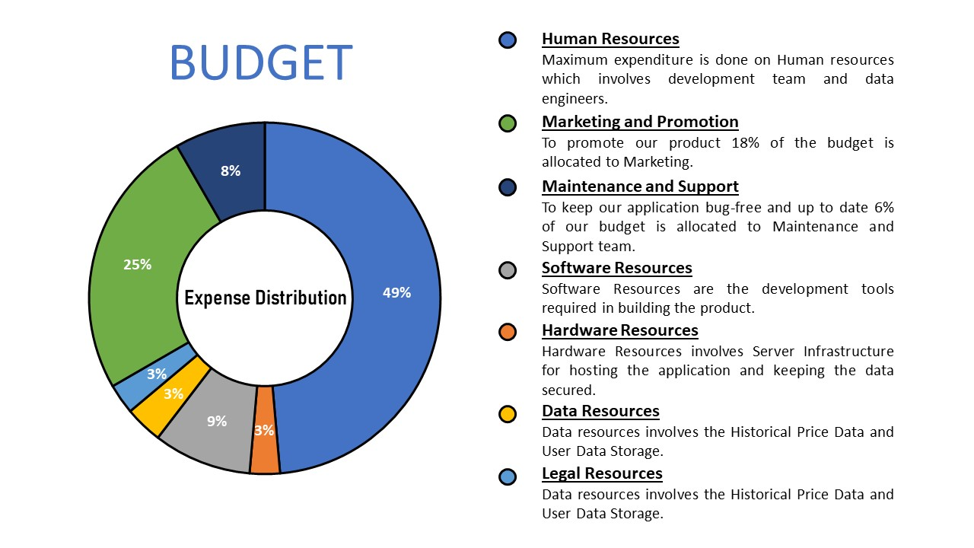

Slide 18
CONCLUSION
In summary, WisePrice represents a groundbreaking solution that has the potential to redefine how businesses and consumers engage with pricing and market dynamics. It embodies the future of data-driven decision-making in the marketplace.
WisePrice: Smart pricing for all.
Advantage: Boosts business and saves consumers time and money.

Slide 19
CONCLUSION
Data Care: Prioritizes security and privacy.
Global Impact: Benefits everywhere.
Vision: Smarter future.
As we move forward, we see WisePrice not just as a standalone product but as a catalyst for innovation and evolution .

Slide 20
Thank You

